Slide 1
Solution Discussion #4
Solutions to problems in HA4 in SSY345 VT24
Victor Pettersson
vicpett@chalmers.se
14th of May, 2024

Slide 2
Grading
Problem 1
1
1
Problem 2
3
1
1
1
Problem 3
0.5
0.5
1
2
2

Slide 3
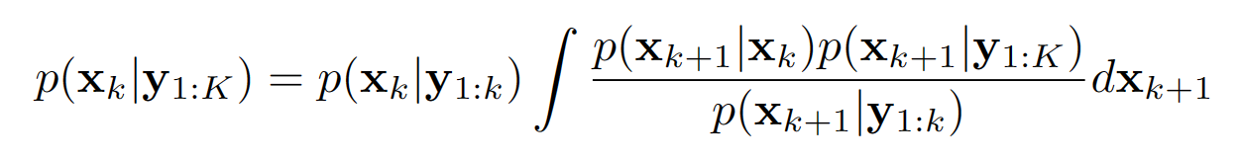
Problem 1 – RTS Smoothing
In your different implementations of the RTS smoother, what quantity/quantities was/were calculated differently?
Can you name the five component densities of the recursive RTS algorithm expression?

Slide 4
Problem 1 – RTS Smoothing
In your different implementations of the RTS smoother, what quantity/quantities was/were calculated differently?
Can you name the five component densities of the recursive RTS algorithm expression?
"P_{k, k+1|k}"
Smoothing distribution at k + 1
Process model
Smoothing distribution
Posterior / Filter distribution
Prediction

Slide 5
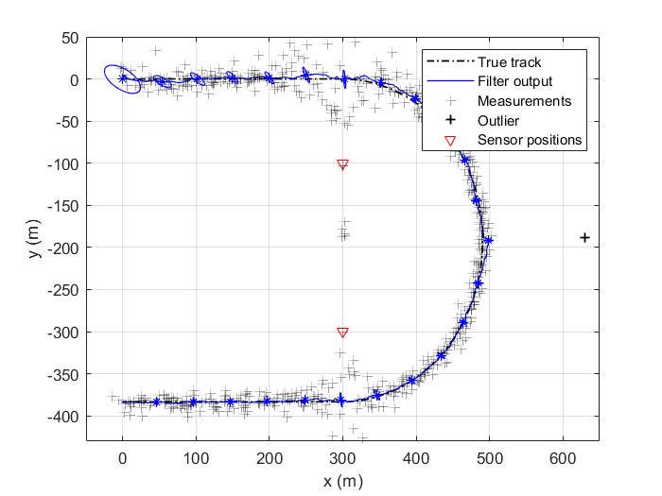
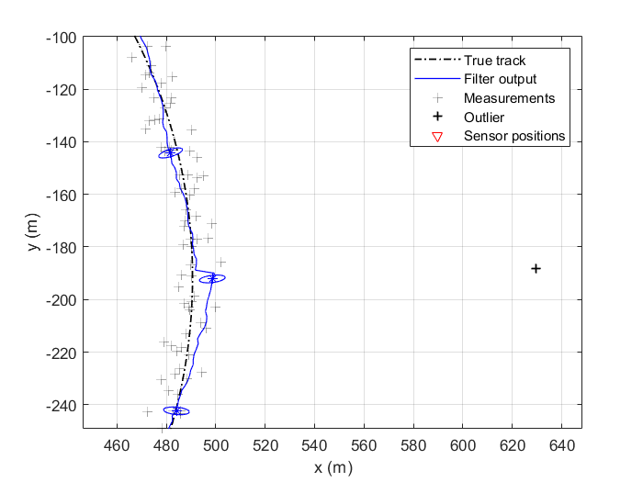
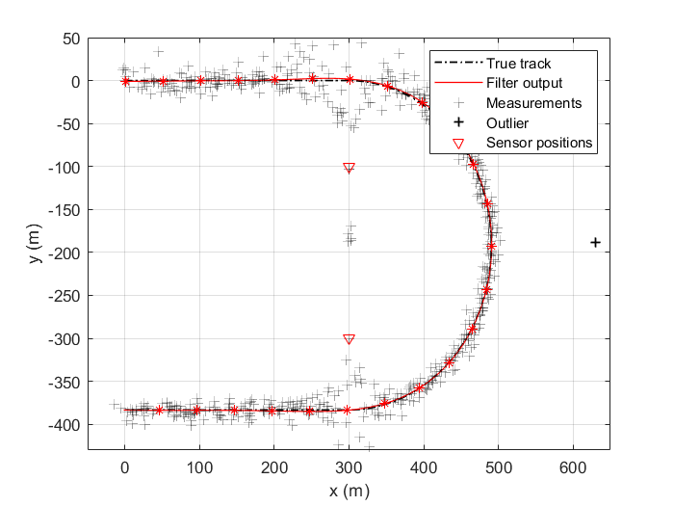
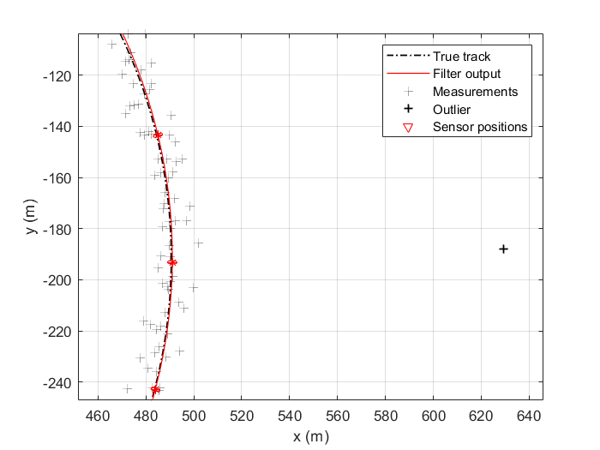
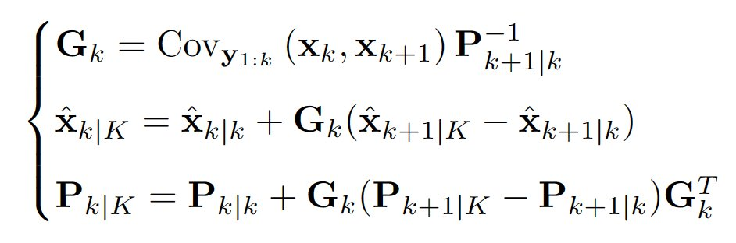
Problem 1 - Solution
Smoothing gives a "smoother" estimate with comparably less uncertainty to the filter output
Less sensitive to outliers

Slide 6
Problem 2 – Particle Filtering
Based on your results, discuss why it's important to perform resampling when running your filter for a significant duration.
How do you expect your filter to perform using an infinite number of particles in this particular case (linear and Gaussian model)?

Slide 7
Problem 2 – Particle Filtering
Based on your results, discuss why it's important to perform resampling when running your filter for a significant duration.
How do you expect your filter to perform using an infinite number of particles in this particular case (linear and Gaussian model)?
To avoid particle degeneration
Like the Kalman filter, since it's optimal

Slide 8
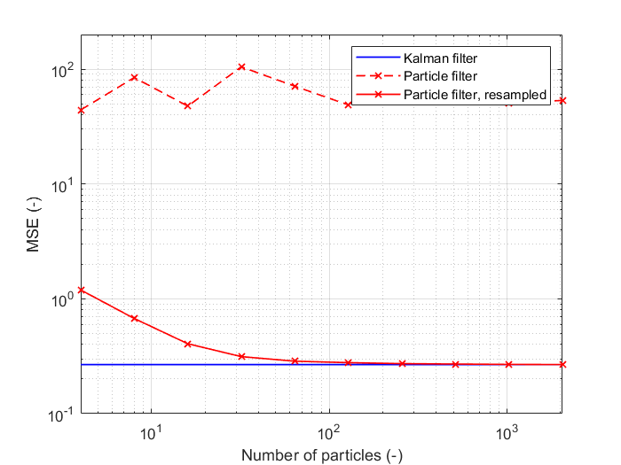
Problem 2 – Solution
Number of particles? Depends on the requirement, here ~ 100 seems OK!
(K = 2000, yours will be more noisy)

Slide 9
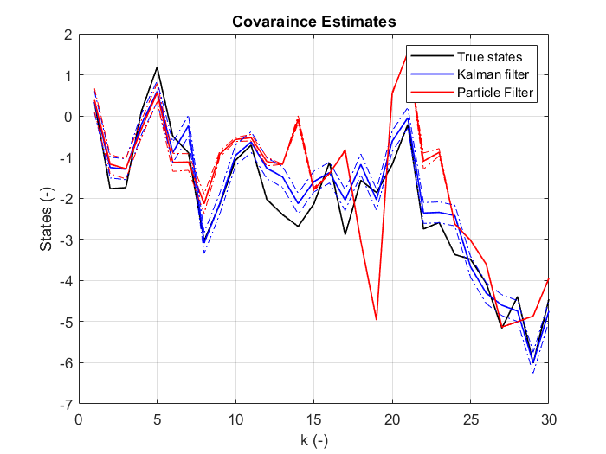
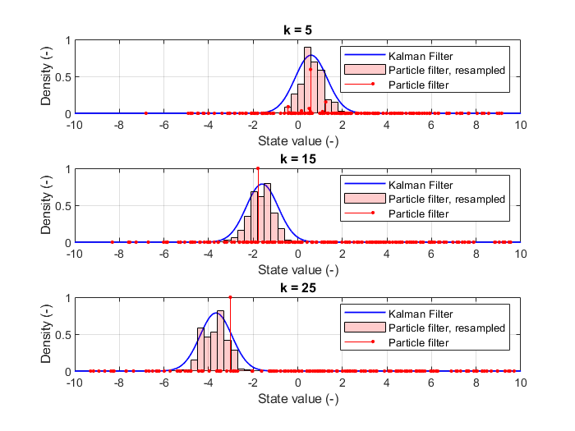
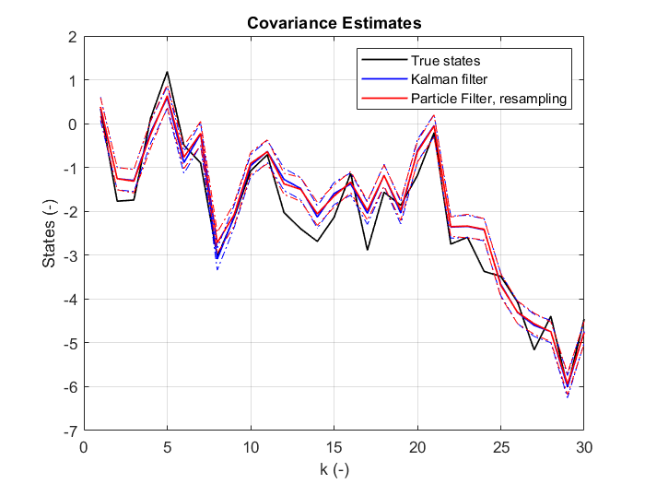
Problem 2 – Solution
No resampling shows signs of degeneracy after only a few iterations.
With resampling resembles Kalman filter well.
(No resampling)
(Yes resampling)

Slide 10
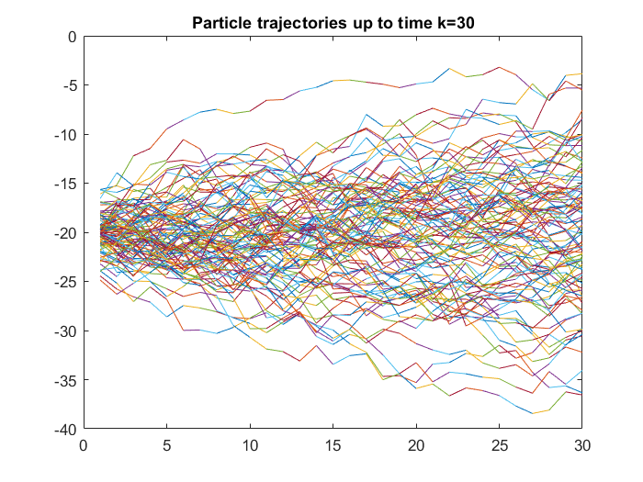
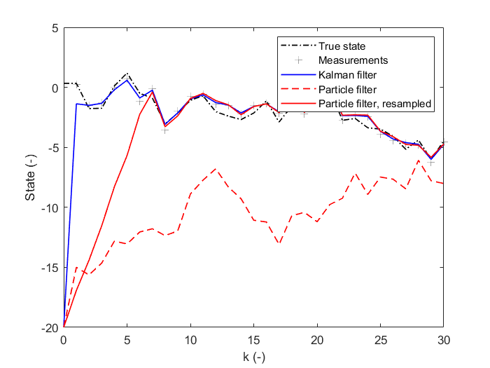
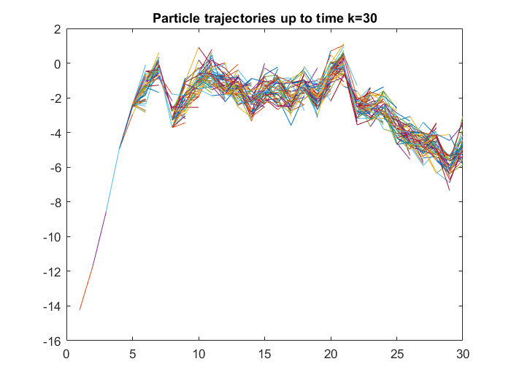
Problem 2 – Solution
Plotting individual trajectories
Faulty prior, RS PF recovers more slowly than Kalman.
(No resampling)
(With resampling)

Slide 11
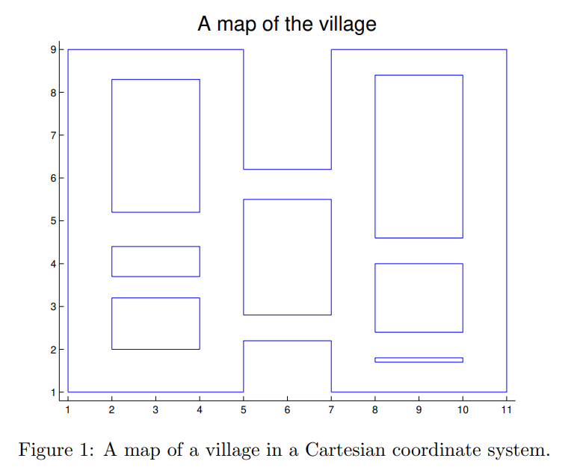
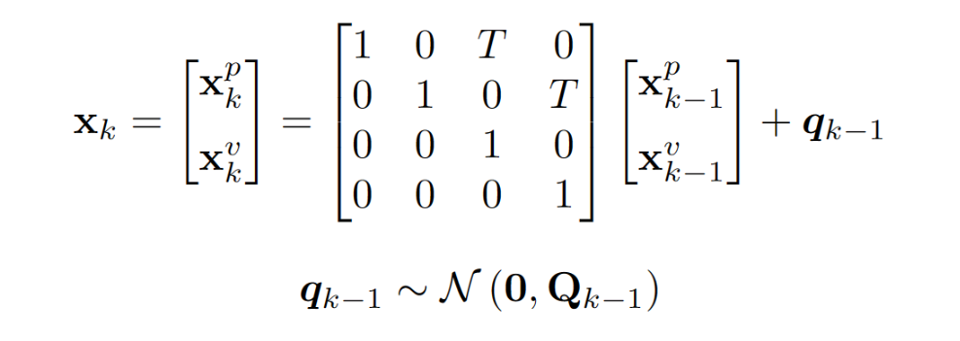
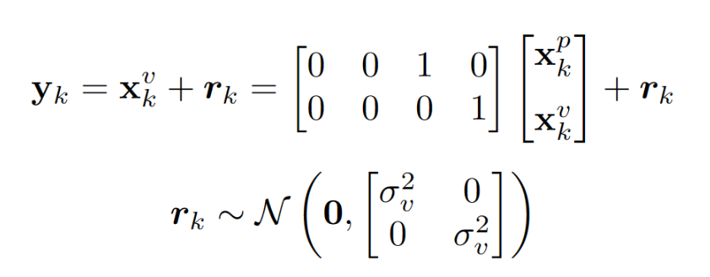
Problem 3 – Modeling
Suggestion, use the CV model for modeling the motion
Measurement model is given

Slide 12
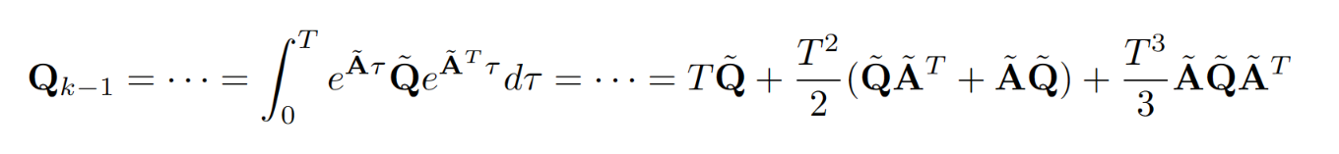
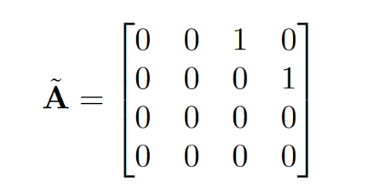
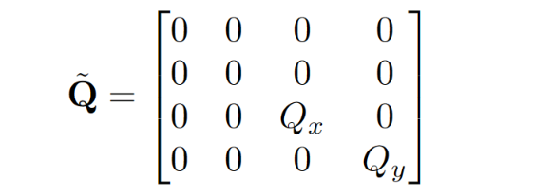
Problem 3 – Motion Noise
Exact discretization of noise, CV model

Slide 13
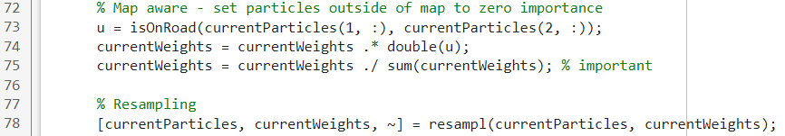
Problem 3 – Map Awareness
The map can be incorporated into the filter as a component of its motion model (off-road particles are improbable)
Set off-road particle weights to zero importance, then resample

Slide 14
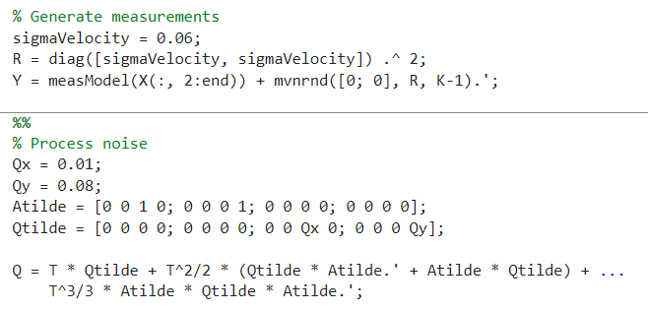
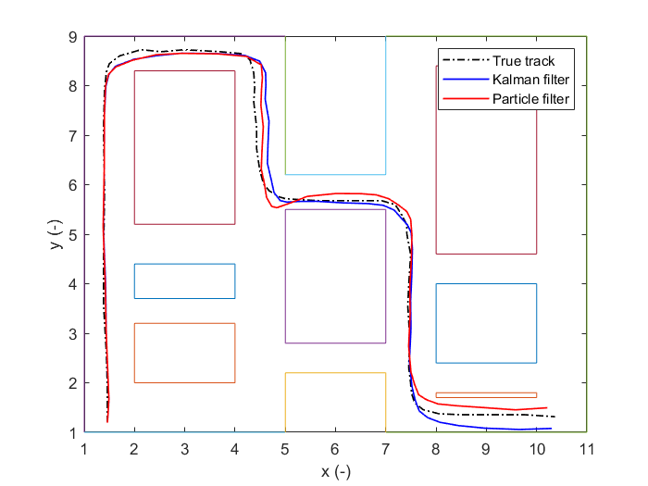
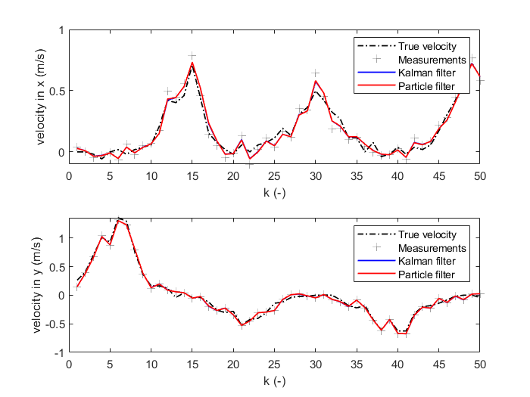
Problem 3 – Known first position

Slide 15
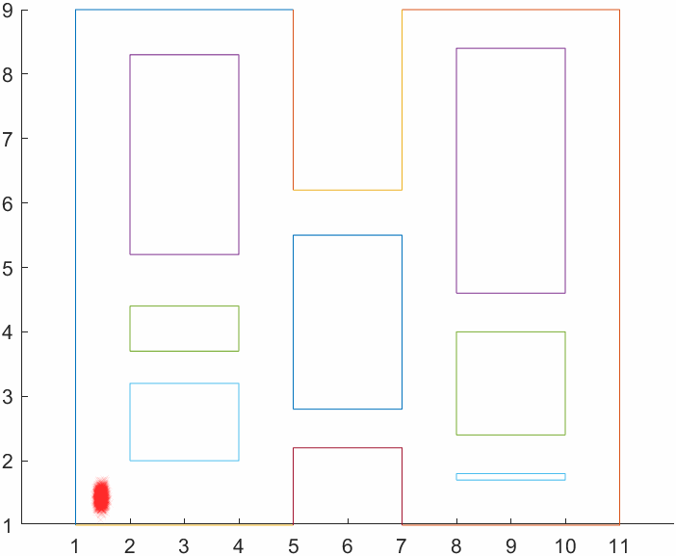
Problem 3 – Known first position

Slide 16
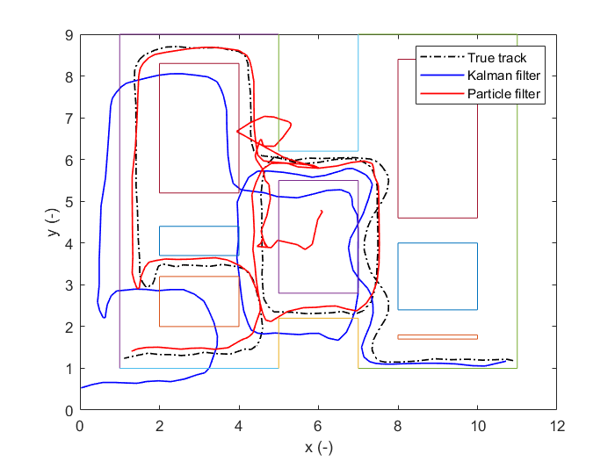
Problem 3 – Unknown first position
Draw uniform samples over whole map (uninformative prior), resample onto road

Slide 17
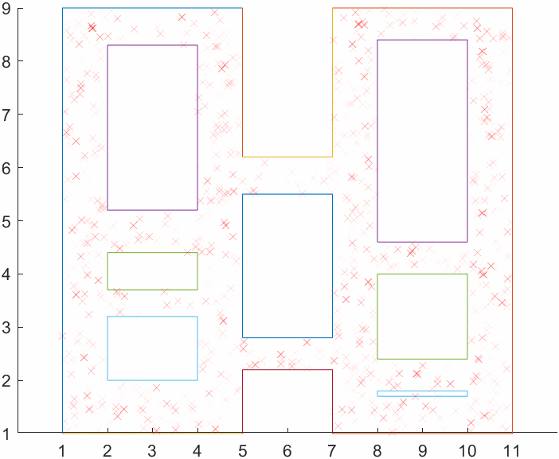
Problem 3 – Unknown first position

